Slide 1

Project Presentation Software Engineering 2
PowerEnJoy – Project Presentation
PowerEnJoy
Share. Be Green. Enjoy!
Team members: Giovanni Scotti – Marco Trabucchi
Professor: Luca Mottola
A.Y. 2016/2017
POLITECNICO DI MILANO

Slide 2

Introduction
PowerEnJoy – Project Presentation
Known issues and numbers:
5 documents and about 200-250 pages.
We will do our best in order to introduce the essence of our project.
IDEA and APPROACH of the presentation:
We discuss the main features and functionalities of our system-to-be, also using examples and real usage scenarios.
The order we follow to describe the documents is the one given by the Waterfall Model – a sequential design process used in software development.
POLITECNICO DI MILANO

Slide 3
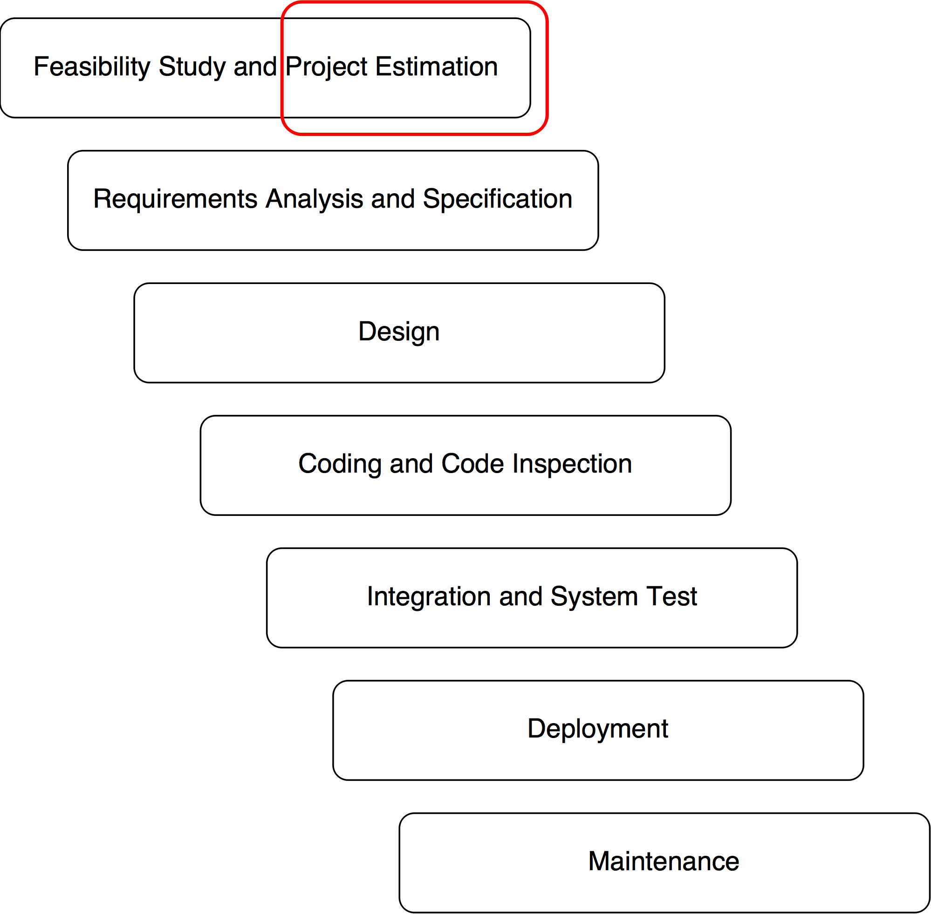
Project Plan Document
PowerEnJoy – Project Presentation
The purpose is to estimate the size, the cost and the effort required by the project.
SIZE: Function Points analysis
COST and EFFORT: COCOMO II and the related Cost Drivers and Scale Factors.
POLITECNICO DI MILANO

Slide 4
Function Points
PowerEnJoy – Project Presentation
ILFs: logical files generated and maintained by the system.
User, Car, Payment, Reservation, Ride, Safe Area…
EIFs: external interface files maintained by an external system.
Payment Information by the Payment Handler, interventions by the maintenance legacy system, maps...
EIs: elementary operations to elaborate data coming from the external environment.
Registration, Login, Update user profile, Data from sensors, Car reservation, Car Unlocking…
EOs: operations that generates data from the external environment involving elaborations of data from logic files.
E-mails notifications, general purpouse notifications, final charges…
EQs: operations that involve input and outputs without significant elaborations of logic files.
View user profile, View reservations, View power grid stations…
POLITECNICO DI MILANO

Slide 5
Function Points
PowerEnJoy – Project Presentation
The final value of UFP is 152.
Using a multiplicative factor of 46, the average number of SLOC is 6992.
Using a multiplicative factor of 67 as an upper bound, the average number of SLOC is 10184.
Both the multiplicative factors are obtained assuming JEE will be the main programming language used to develop the project.
POLITECNICO DI MILANO

Slide 6
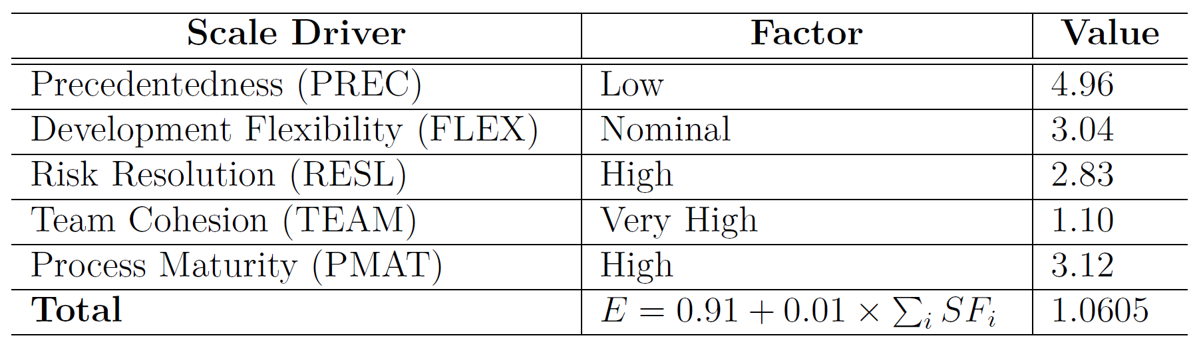
COCOMO II – Scale Drivers
PowerEnJoy – Project Presentation
The Scale Drivers reflect the non-linearity of the effort with relation to the number of SLOC.
They determine the exponent E used in the effort equation.
POLITECNICO DI MILANO

Slide 7
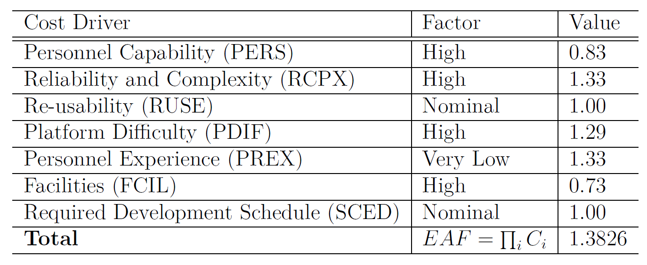
COCOMO II – Cost Drivers
PowerEnJoy – Project Presentation
Cost Drivers act as multiplicative factors on the effort needed to carry out the project.
Since we are at the beginning of the life-cycle of the project and the team is exploring and evaluating different architectural alternatives, the point-of-view will be that of the Early Design fashion of the COCOMO model.
POLITECNICO DI MILANO

Slide 8
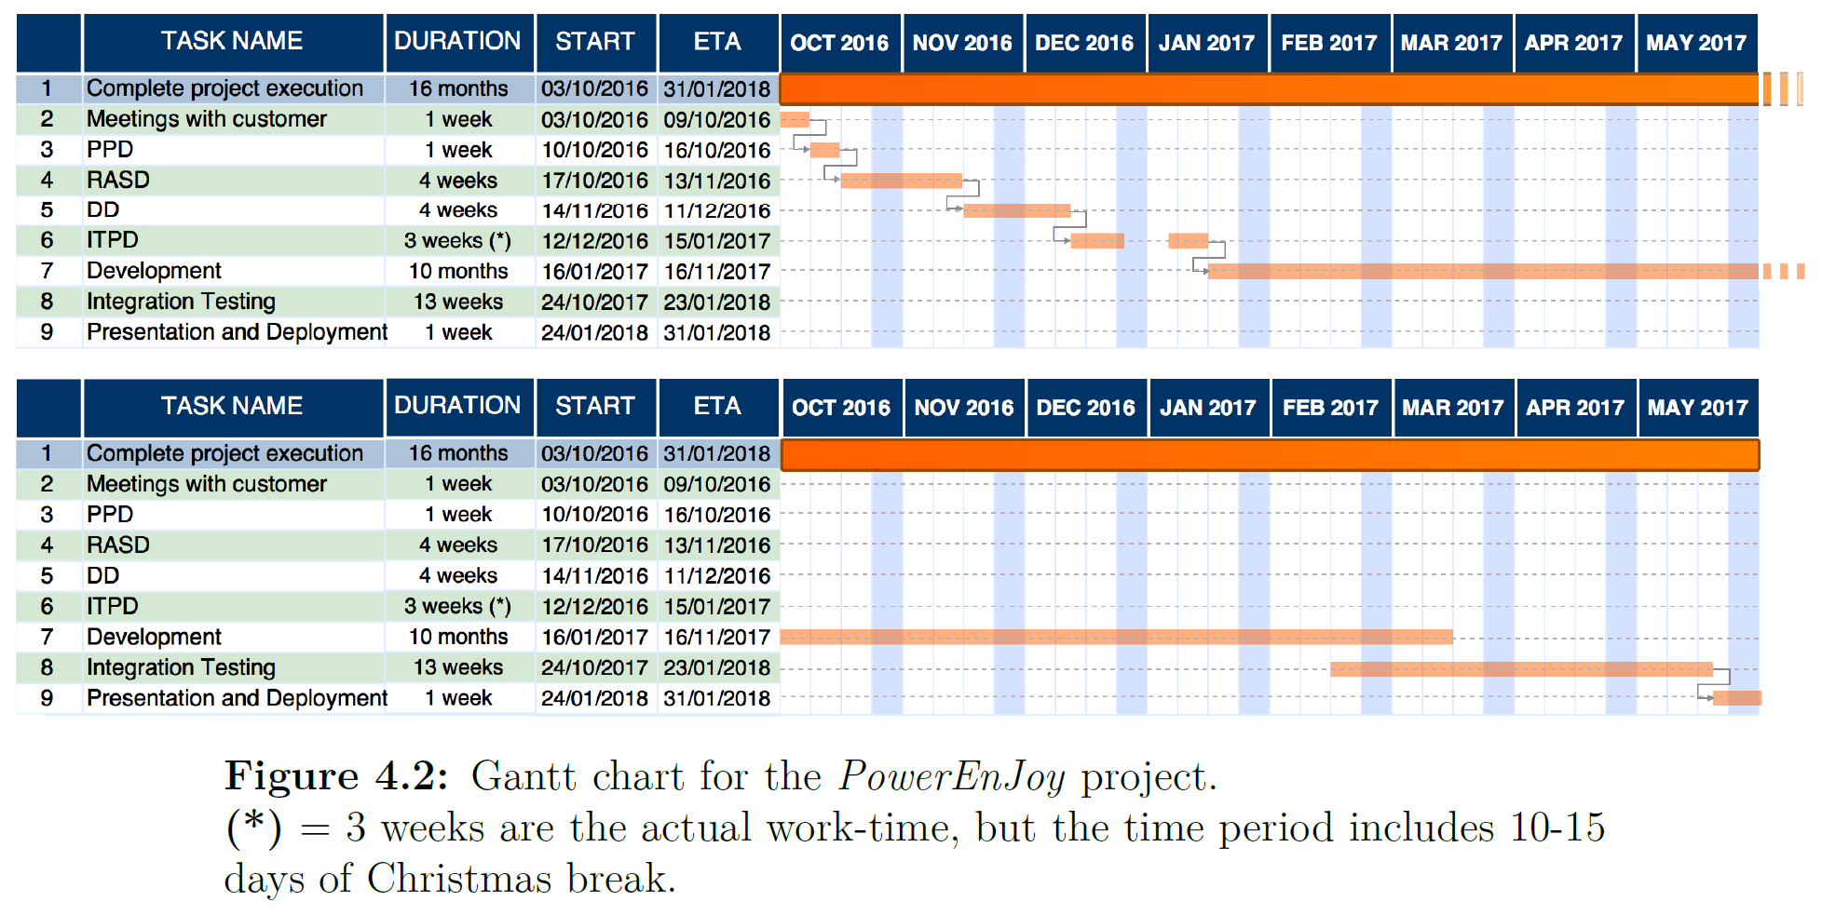
COCOMO II – Schedule Estimation
PowerEnJoy – Project Presentation
The total effort results in 31.97 person-months with an upper bound of 47.64 person-months.
Since our team is composed of 2 people, we assume an overall project duration of about 16 months.
POLITECNICO DI MILANO

Slide 9
PPD – Risks and Contingency Plans
PowerEnJoy – Project Presentation
The main risks that might threaten our project are the following:
Project Risks:
Deadlines not met: in this case a first release with the main functinalities will be offered, followed by other releases concerning less important features.
Team break-ups: to avoid this risk each team member must be valued in the same way.
Technical Risks:
Interaction with external systems: failures involving such components constitute a severe risk for our system. We must maintain a close collaboration with development teams of the partners.
Economical Risks:
Competitors: in order to avoid economical losses brought by possible competitors, we must continuously provide new appealing functionalities also based on the customer feedback.
POLITECNICO DI MILANO

Slide 10
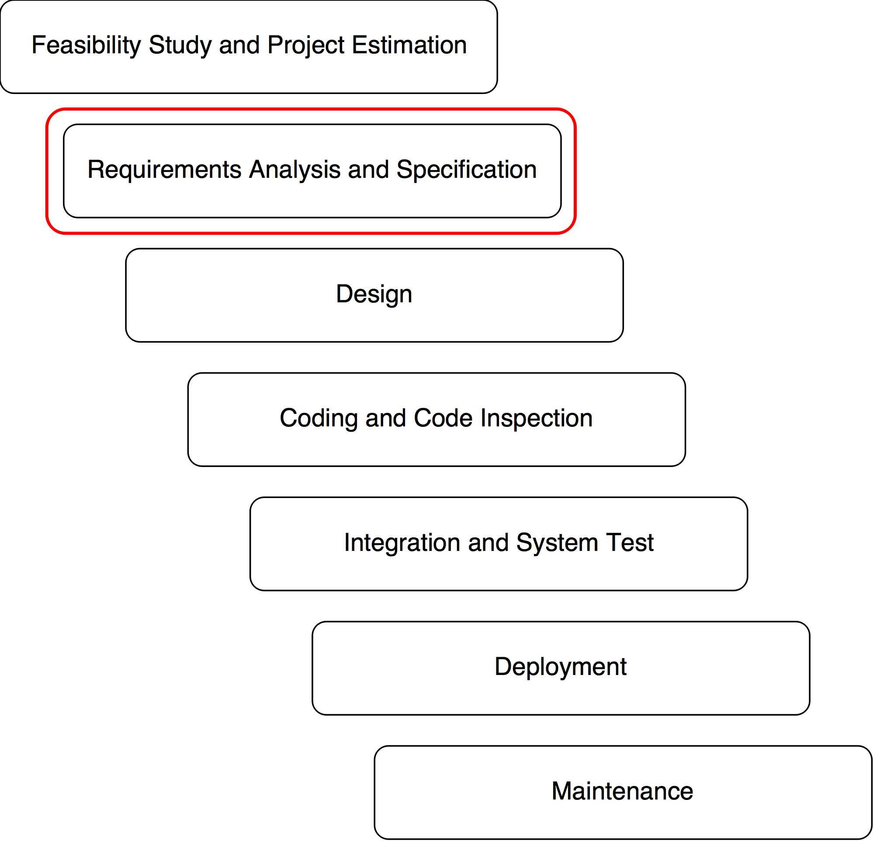
Requirements Analysis and Specification Document
PowerEnJoy – Project Presentation
«Without requirements or design, programming is the art of adding bugs to an empty text file.»
The purpose of the document is to find out which are the requirements of the system-to-be, based on the goals to be achieved and reasonable domain assumptions.
We analyze the way in which the system could handle realistic scenarios based on the outcome of the analysis, with the support of diagrams and examples.
POLITECNICO DI MILANO

Slide 11
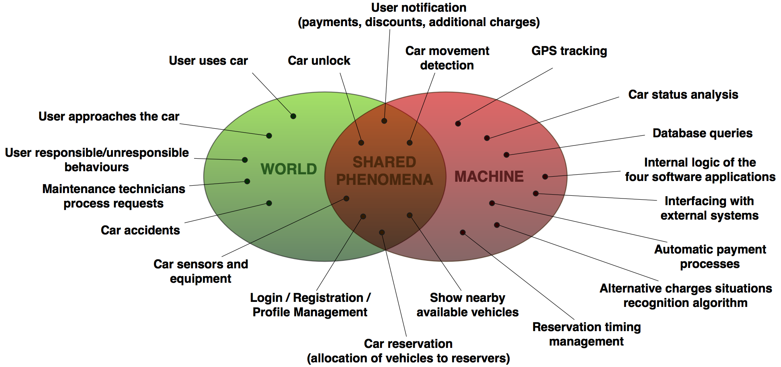
World and Machine Model
PowerEnJoy – Project Presentation
POLITECNICO DI MILANO

Slide 12
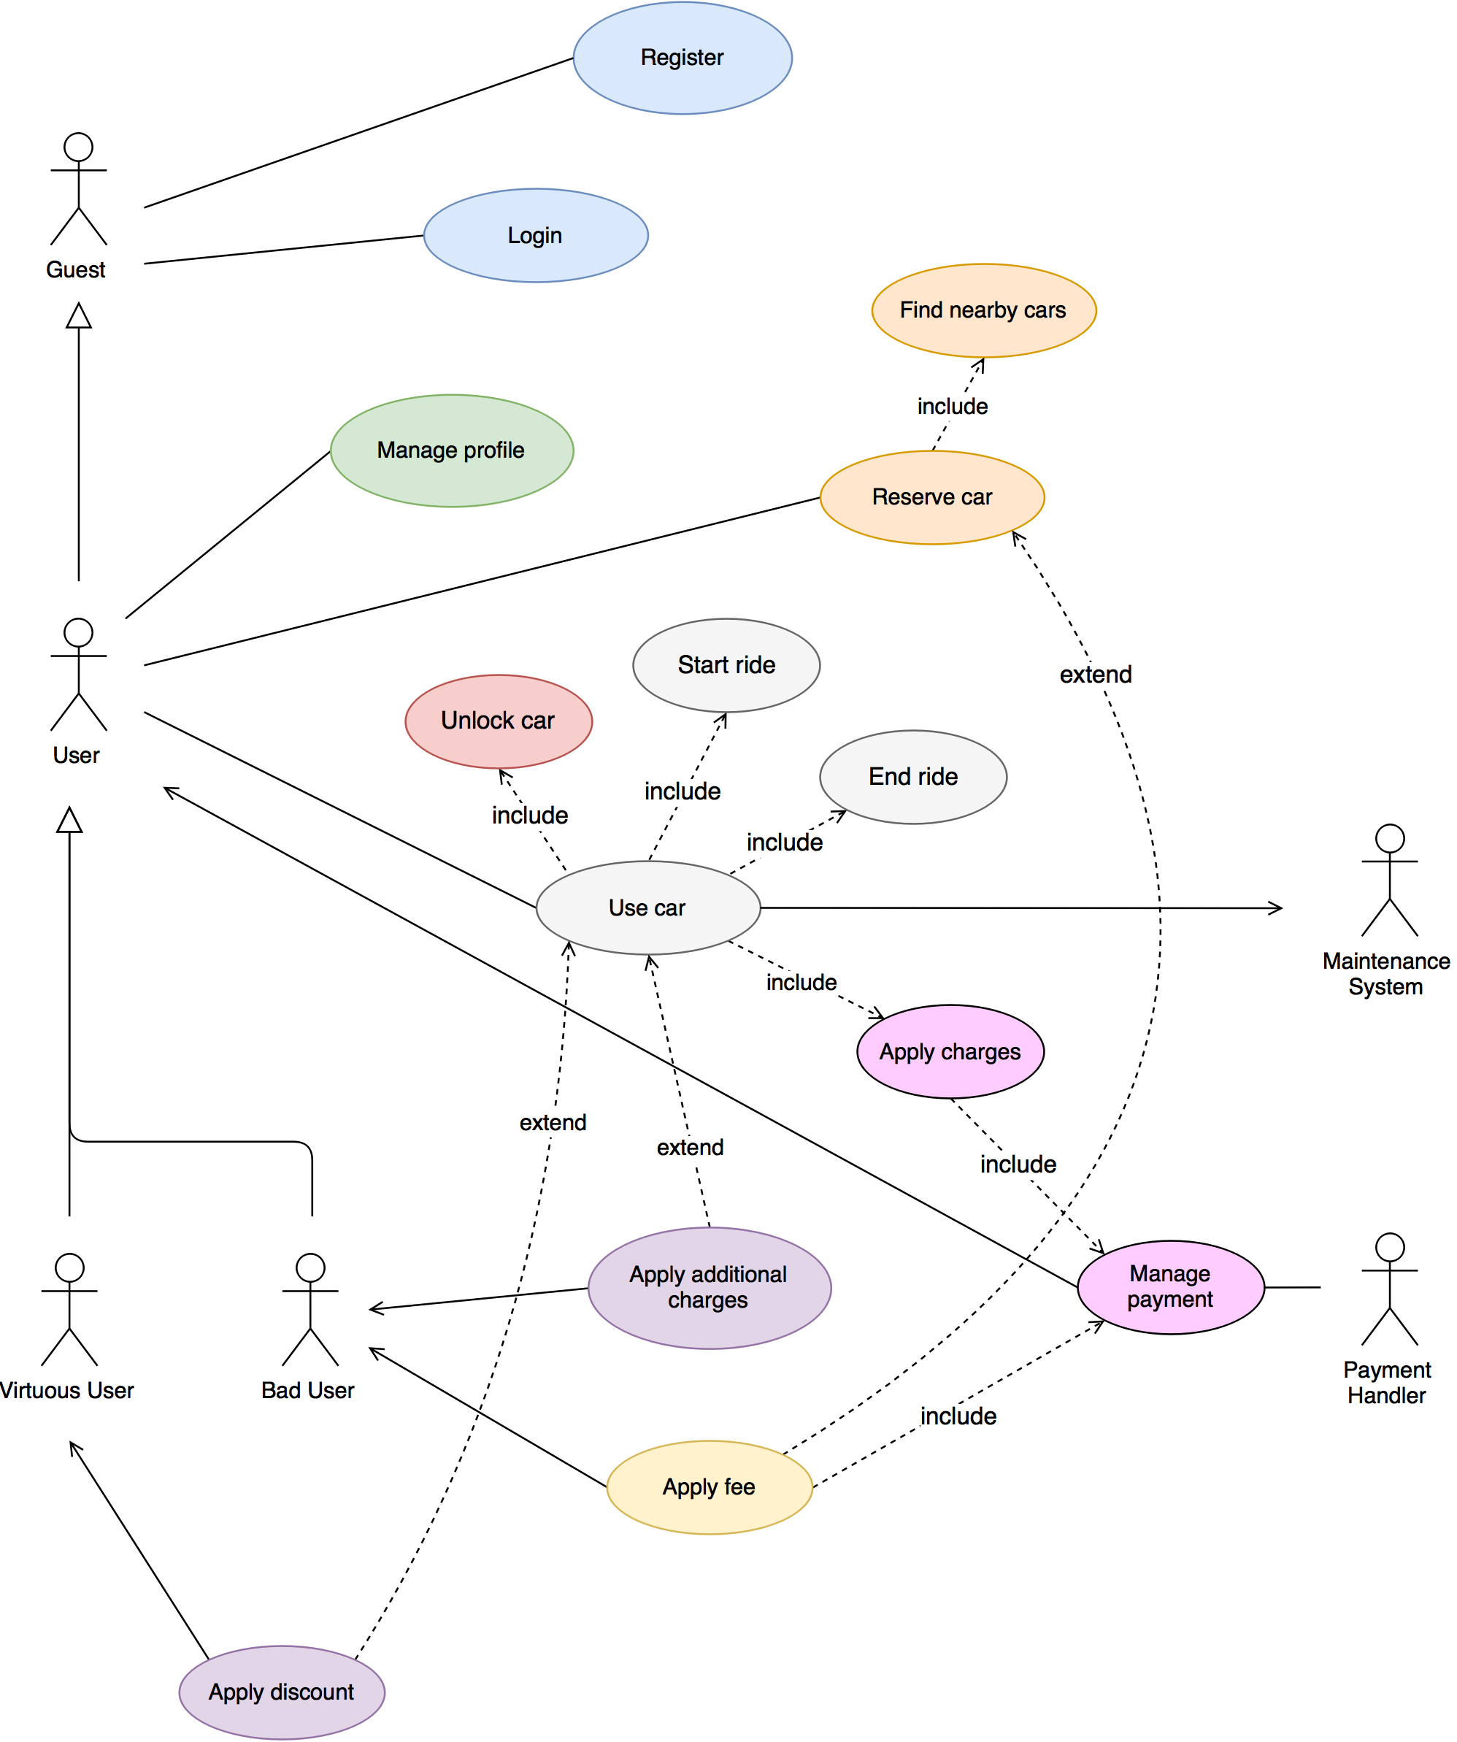
Use Cases
PowerEnJoy – Project Presentation
The subdivision of use cases highlights how different functionalities of the system help in defining the goals.
POLITECNICO DI MILANO

Slide 13
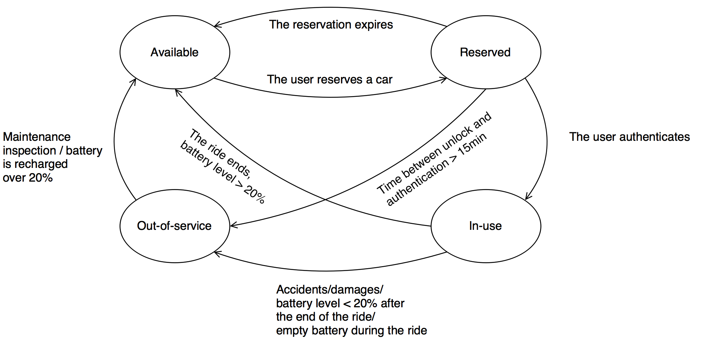
Car Status Management
PowerEnJoy – Project Presentation
POLITECNICO DI MILANO

Slide 14
The IKEA Scenario
PowerEnJoy – Project Presentation
Alice decides to go to IKEA to buy a new piece of furniture for her new apartment. Having no car available, she decides to rent a nearby shared electric car. She easily finds the car, unlocks it and drives to the shopping center. After parking the vehicle, she realizes that she is not sure to find a car after shopping.
The system admits several outcomes:
having no restrictions on consecutive reservations for the same person, Alice could immediately reserve the same car again and come back within an hour.
Alice could hope to find the same or another shared car to go back home, without guarantee on car availability in that area.
(Assuming that the IKEA is in the Safe Area!)
POLITECNICO DI MILANO

Slide 15
…outside the Safe Area?
PowerEnJoy – Project Presentation
Speaking of that… What if a user tries to end a ride outside the Safe Area?
The defined set of requirements imposes that the system keeps charging the user preventing him/her to end the ride, while notifying the issue.
(The system continuously shows the boundaries of the Safe Area to help ‘distracted’ users…)
POLITECNICO DI MILANO

Slide 16
…power grids?
PowerEnJoy – Project Presentation
How to recognize virtuous users recharging vehicles after use?
The system, throughout its functionalities, provides for a brief period of time - 5 minutes - in which it suspends the ‘apply charges’ procedure and waits for an indication of the car being plugged in the power grid.
If this happens, the system is able to apply the corresponding discounts and recompute the final charges before automatically carrying out the payment.
POLITECNICO DI MILANO

Slide 17
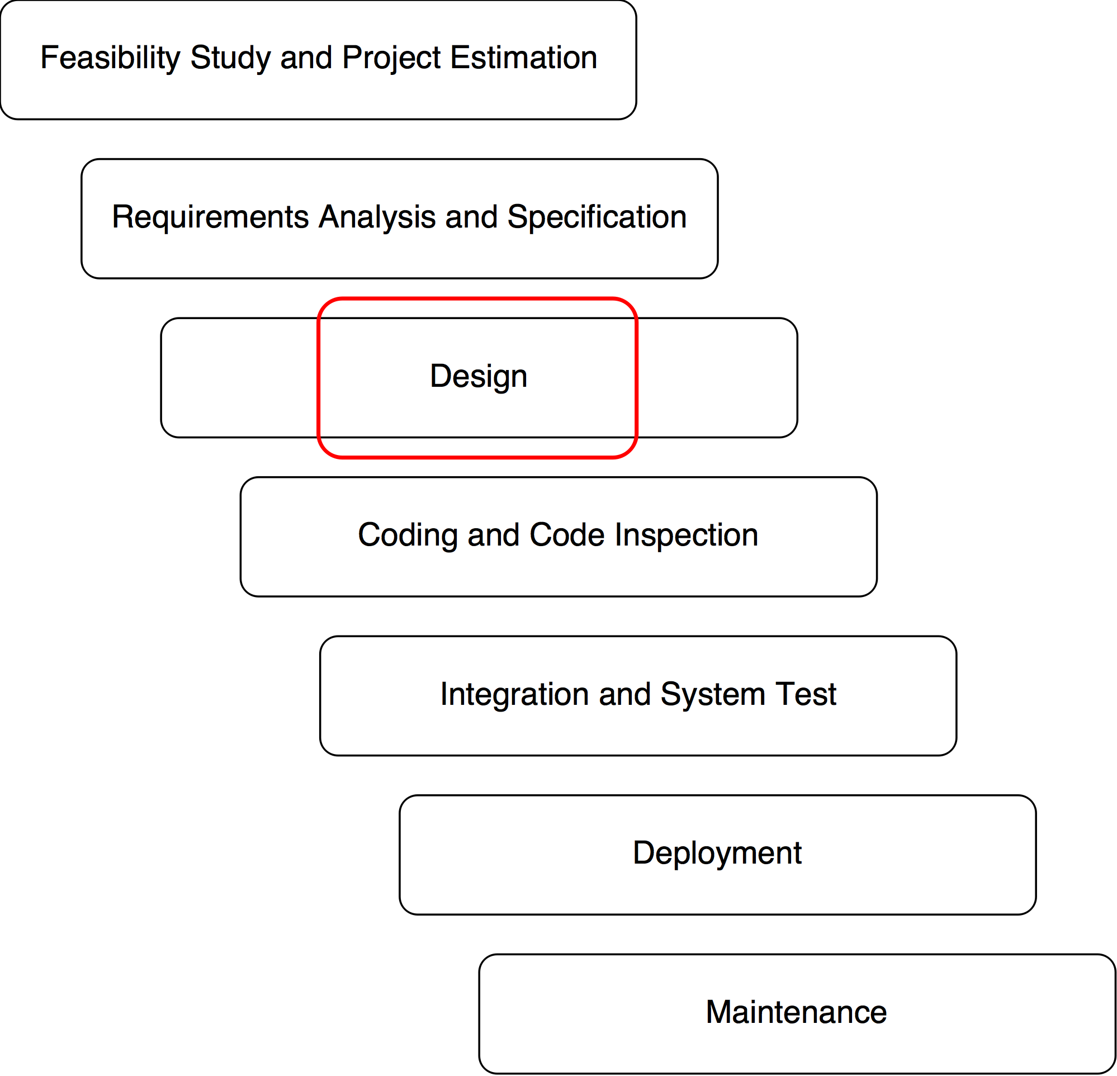
Design Document
PowerEnJoy – Project Presentation
The Design Document deals with:
Architectural design
Algorithm design
Discounts and additional charges computation
User Interface design
UX diagrams
User interface (Web, Mobile, On-Board…)
Requirements traceability
Functional and non-functional requirements
POLITECNICO DI MILANO

Slide 18
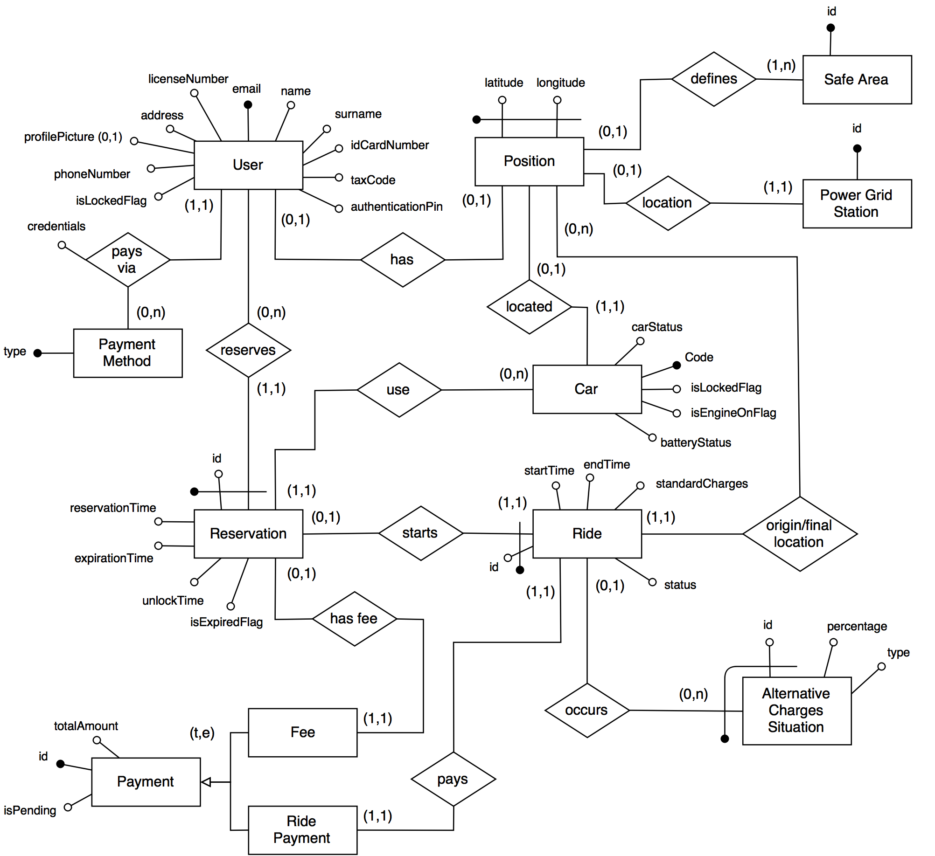
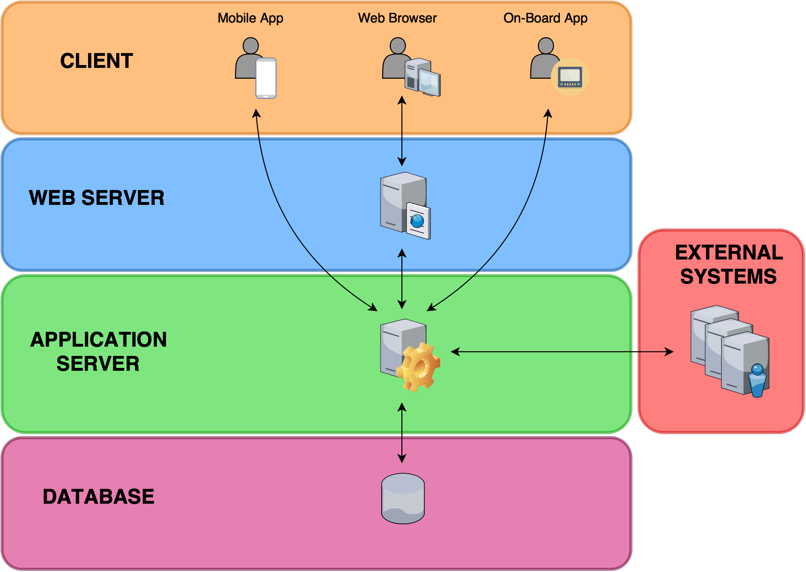
Architectural Design
PowerEnJoy – Project Presentation
Multi-tier client/server architecture. We followed a top-down design approach which led us to enrich the high level structure of the system.
Layered structure of the system
Draft of the E-R diagram
POLITECNICO DI MILANO

Slide 19
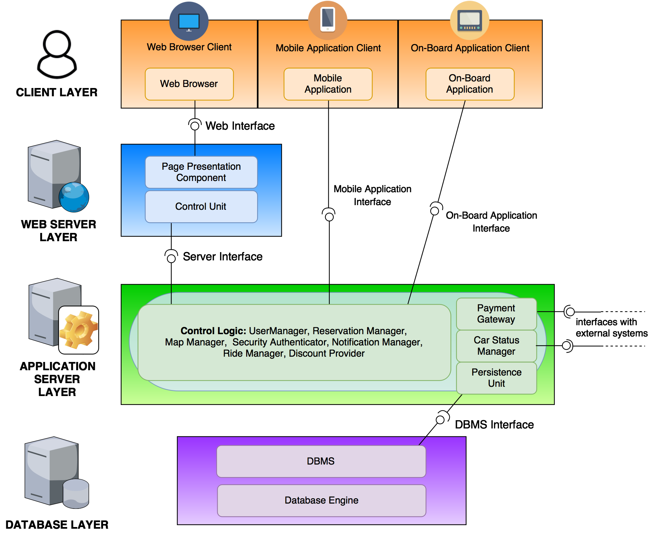
Top Down - From general to specific…
PowerEnJoy – Project Presentation
The detailed global component view gives us a clear picture of what will be implemented using JEE technology. In particular:
The business logic modules are implemented by stateless Session Beans, therefore no data is lost if an instance fails.
Java Perisistence API together with Entity Beans create the persistence unit in order to communicate with the Database.
The Web Server takes advantage of JSP technology to offer the presentation logic based on the MVC pattern.
POLITECNICO DI MILANO

Slide 20
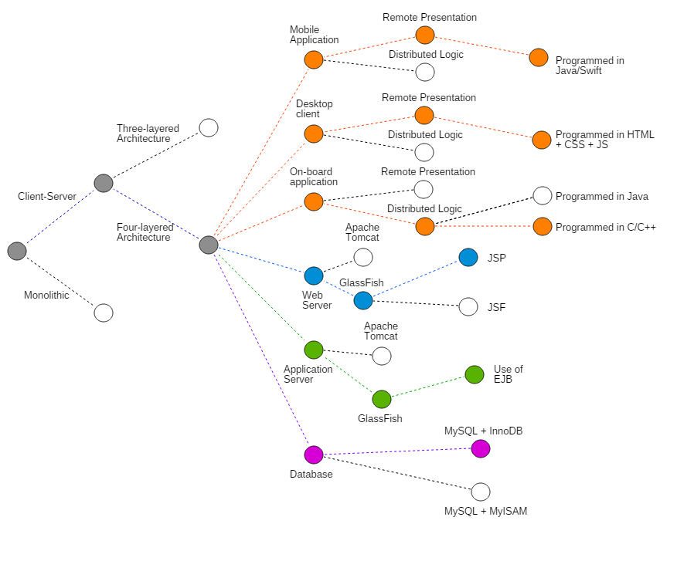
Design Decisions
PowerEnJoy – Project Presentation
Summing up…
POLITECNICO DI MILANO

Slide 21
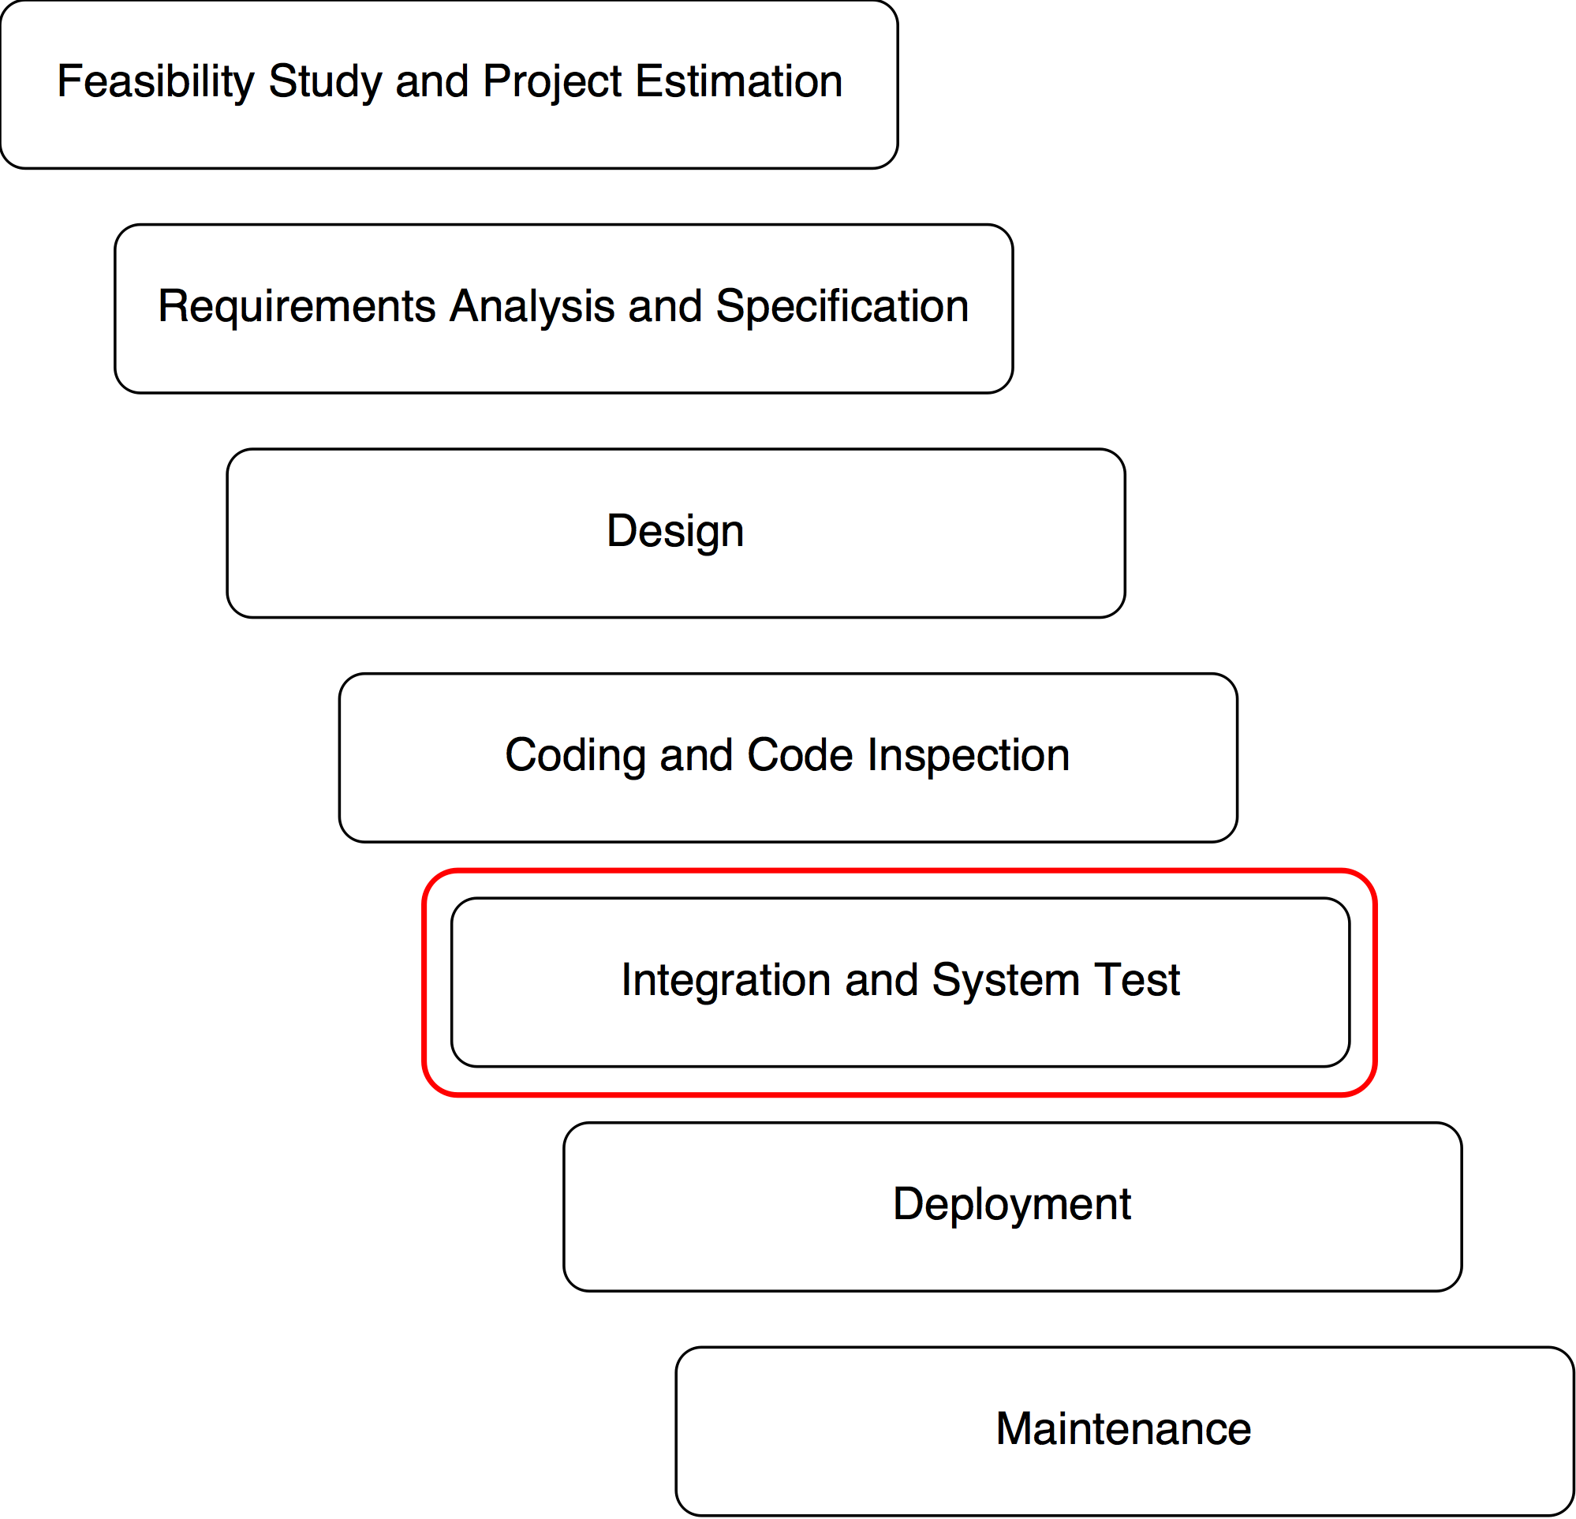
Integration Test Plan Document
PowerEnJoy – Project Presentation
The Integration Test Plan Document deals with:
Establishing order of integration for components and subsystems.
Defining necessary structures - drivers, stubs… - for each test case.
Defining suitable procedures to perform efficient tests.
POLITECNICO DI MILANO

Slide 22
Entry Criteria
PowerEnJoy – Project Presentation
Some preconditions for this phase:
Documentation: classes and methods must be clearly described wrt what they should do and how they should do so.
Unit Tests: individual components must work properly wrt their internal functions.
Code inspection/Analysis: code structure must be compliant to the standard conventions, program flows and data flows must not contain useless or unreachable segments.
RASD and DD: clear indications about requirements and architectural design must be given, minor changes must be immediately reflected if they affect integration.
The chosen approach is the bottom-up integration with focus on critical modules first; the criteria correspond to the natural order introduced by the architectural choices described in the DD: modularity of components, hierarchical nature of dependencies…
POLITECNICO DI MILANO

Slide 23
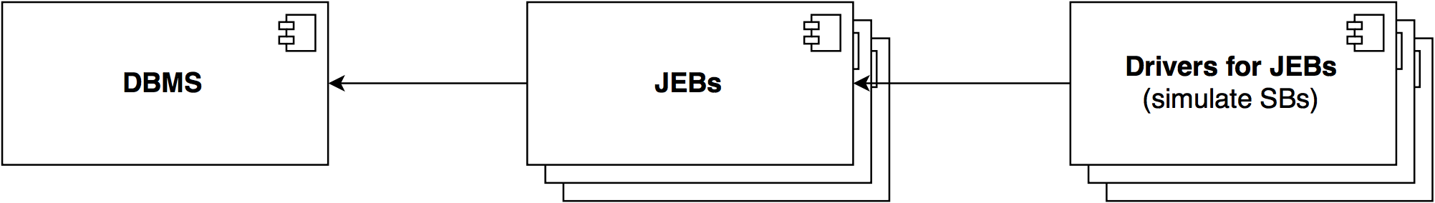
Data Access
PowerEnJoy – Project Presentation
The integration starts from the database components and their interfaces: these represent the most independent compnents of the system, upon which most logical components rely.
The interface exposed by the DBMS must be tested using drivers that simulate access to every resource.
The logical representation of DB entities must be tested in turn, by calling every offered method (by means of an appropriate set of drivers).
POLITECNICO DI MILANO

Slide 24
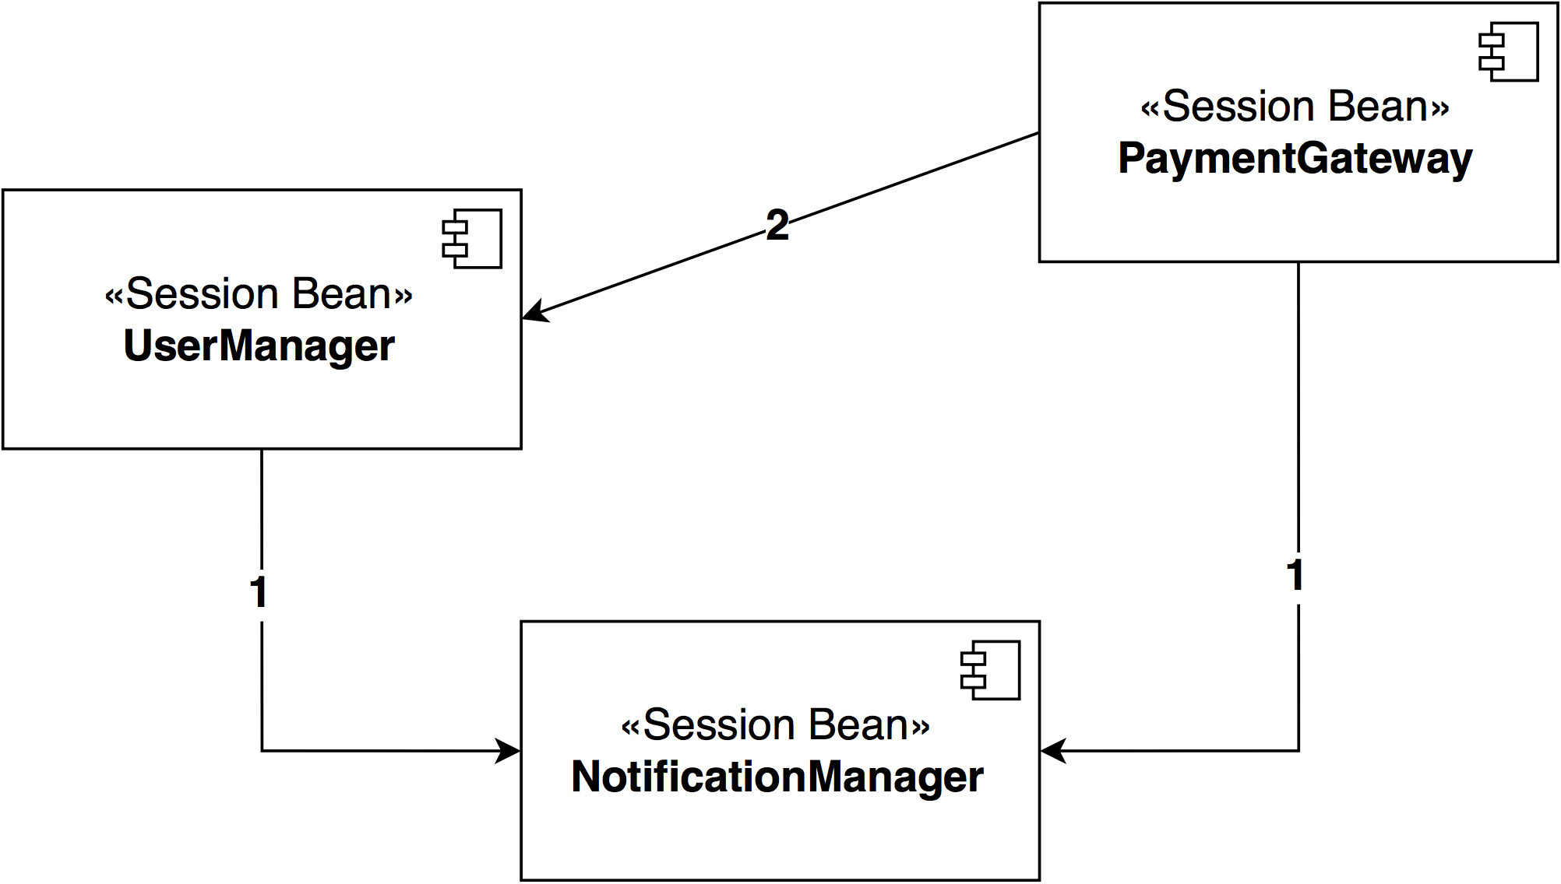
User and Utilities Management
PowerEnJoy – Project Presentation
Similarly, we start from the most independent component whitin each logical group (container).
In this case, the integration starts from the notification manager, whose exposed interface methods are called by one or more drivers that simulate the components ‘using’ it.
As decided in the architecture, the set of drivers will be gradually substituted with real components, that will need other drivers to be integrated as well.
POLITECNICO DI MILANO

Slide 25
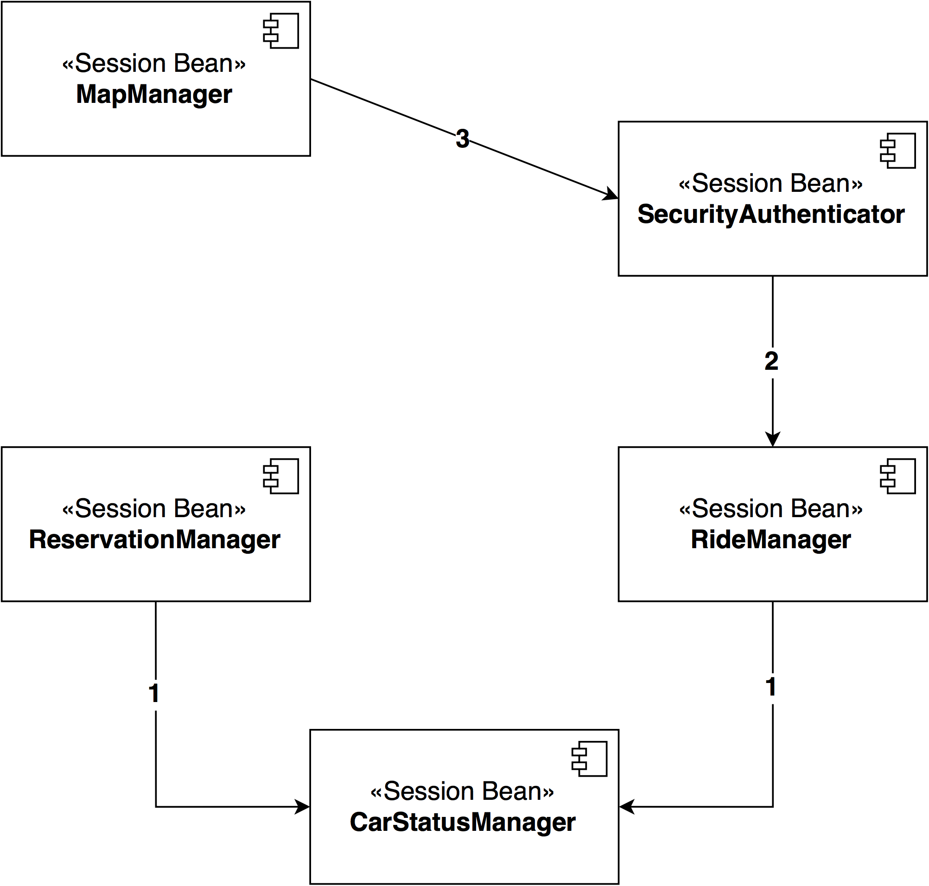
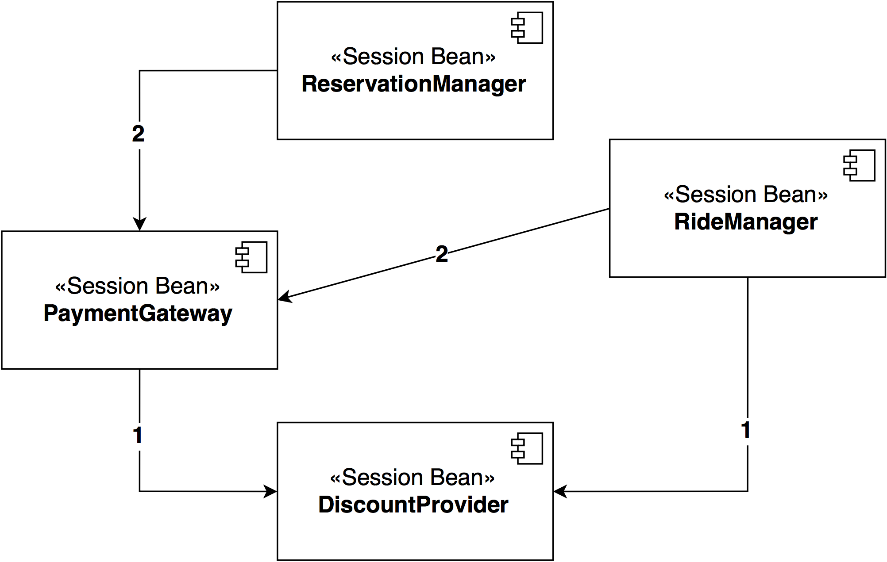
Payment, Ride and Reservation Management
PowerEnJoy – Project Presentation
Same goes for the other logical groups.
Order of integration always depends on the natural dependencies induced by architectural choices.
Payment management
Ride and Reservation management
POLITECNICO DI MILANO

Slide 26
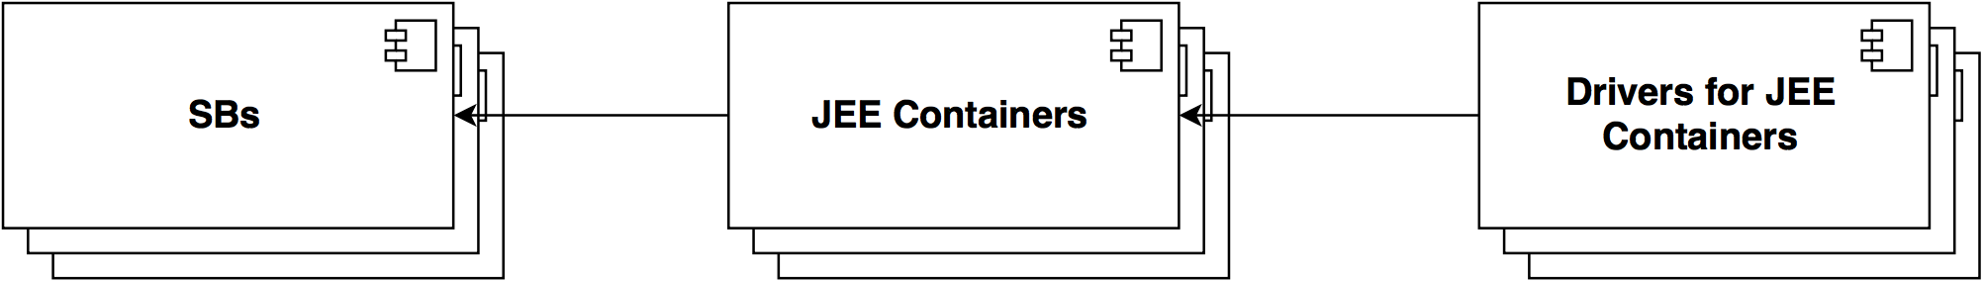
Integration of Upper Levels
PowerEnJoy – Project Presentation
In a simpler way, all containers must be integrated last, using drivers that simulate requests for bean instances.
POLITECNICO DI MILANO

Slide 27
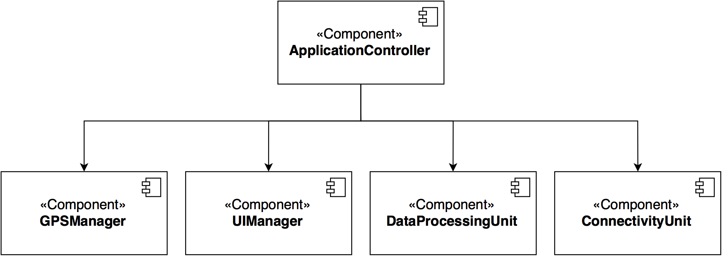
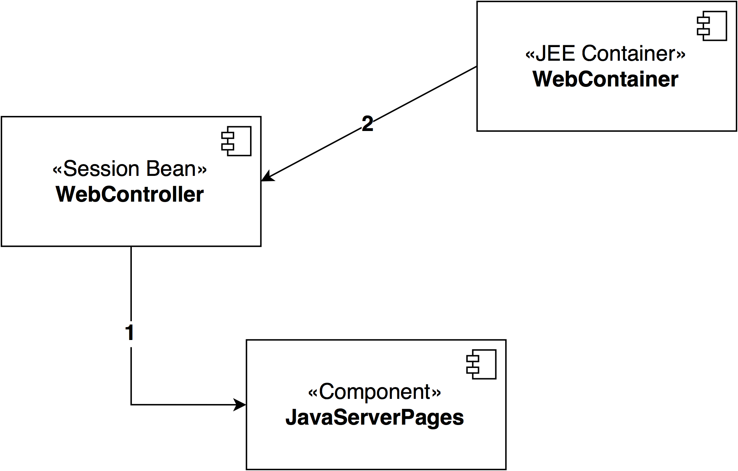
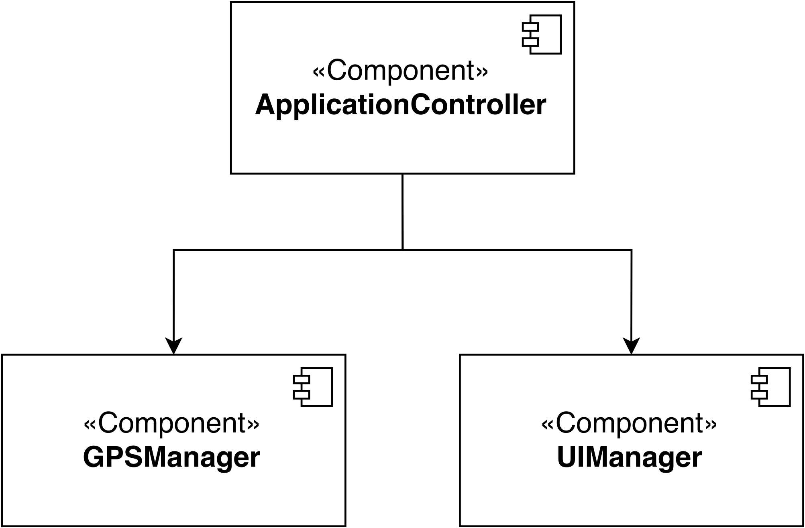
Integration of clients
PowerEnJoy – Project Presentation
Since all clients have a similar ‘controller-centric’ structure, integration must be done individually for each component; the controllers manage interactions internally.
On-Board application
Mobile application
Web application
POLITECNICO DI MILANO

Slide 28
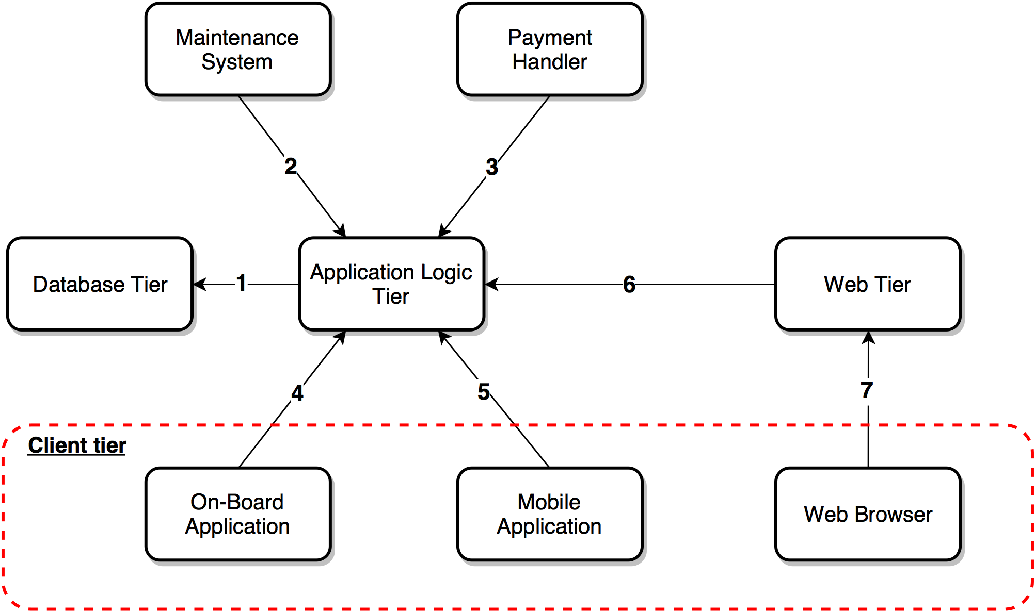
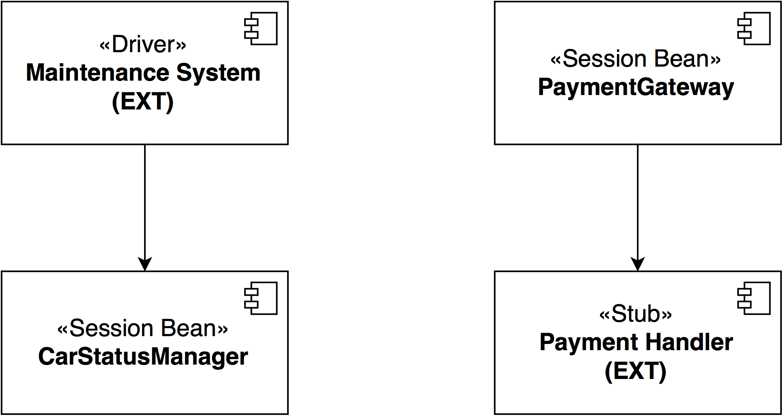
Integration of Subsystems
PowerEnJoy – Project Presentation
Subsystems must be integrated starting from the most critical part.
The Application Server, which represents the logical coordination of the system, naturally occupies a central position.
Note the explicit need to integrate with the external systems: drivers or stubs for the endpoints based on the type of interaction.
POLITECNICO DI MILANO

Slide 29
Test Cases Structure
PowerEnJoy – Project Presentation
All test cases follow the same structure:
Identifier;
Test items: involved components;
Input specification: procedure calls to be performed to test the integration of test items;
Output specification: expected outcome of the test;
Environmental needs: how the context in which the test is performed should be;
Test description: purpose and content of the test case;
Testing method: used tools/methodologies.
POLITECNICO DI MILANO

Slide 30
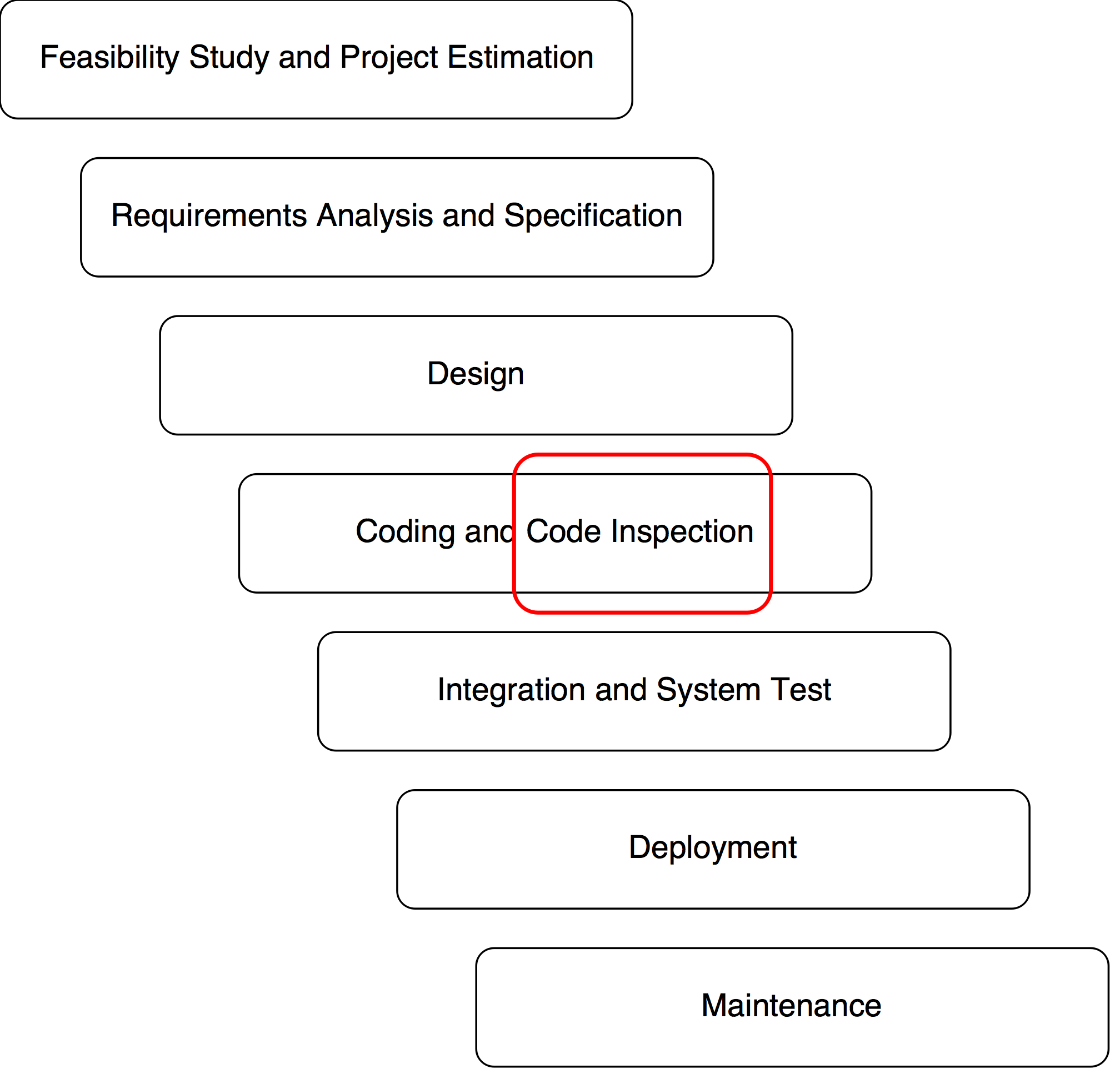
Code Inspection
PowerEnJoy – Project Presentation
This phase was carried out for a real open-source system (which is completely distinct from the one we are describing here), but still was part of the same project assignment.
POLITECNICO DI MILANO

Slide 31

Target of Inspection
PowerEnJoy – Project Presentation
The inspection covered a single relevant class within a module of the complex system offered by Apache OFBiz, an open-source ERP + CRM.
In particular, the target of the inspection process was the ‘ModelDataFileReader.java’ class within the ‘datafile’ package. The class is in charge of the conversion of data files represented in XML format into an object-based representation, in order for them to be used in the Java environment provided by OFBiz.
POLITECNICO DI MILANO

Slide 32
Analysis Procedure and Outcome
PowerEnJoy – Project Presentation
The process for accomplishing the task was split in 2 phases:
analysis and understanding of the role and functioning of the class.
analysis of the real code in order to find the issues based on a given checklist.
Most of the issues in the code are convention violations regarding code structure (parenthesizing, line length, capitalization…)
Many of them involve incompleteness or total lackness of proper documentation. A minority of the issues is related to code and naming cleanness and clarity.
The analysis of the class exposes some potential issues with other classes of the package (ModelDataFile.java, ModelRecord.java and ModelField.java).
POLITECNICO DI MILANO

